Slide 1

Medical Search Engine : I-MedWiki
Web Health Informatics
Supervised By: Dr. Vijay Mago
By:
Ankit Raj Jasmeet Singh Grewal Ramanpreet Kaur Deol

Slide 2

Do we really need another search Engine??

Slide 3


Slide 4
Search Text (Medical Symptoms)
Selecting links from a pool of medical and non-medical page suggestions.
Verification & Analysis
Final Data
Medical Data Collection

Slide 5
Introduction:
This project would conclude with the creation of a medical search engine, named
I-MedWiki, that would be efficient to search about symptoms and in response would be able to show us categorical results based on the research done related to those symptoms, to avail user with the required knowledge about the same.

Slide 6
Search Text (Medical Symptoms)
Final Data:
Categorical data on the basis of research analysis
Medical Data Collection

Slide 7
Key Features:
Efficient to generate high quality content: This search engine would be self-efficient to search the symptoms based on the disease that encounters with them. No such results would be fetched that does not have any medical background such as research journal or scholar papers related to the topic (symptom) being searched.
Non-redundancy: There would be no duplicate data fetched through this application.
Non-Clumsiness: The links or data fetched would be well categorized on the basis of different diseases that have the same symptoms.
Single Objective Search engine: Since the search engine would basically serve as a medical dictionary, thus, there would be no results for any term outside the medical scope.

Slide 8
The Prototype
Visit the following URL to view the prototype of the same:
https://projects.invisionapp.com/share/BFA6L4CW9

Slide 9
Technology Used
HTML5 & Java (JSP/servlet): frontend
Connection to Google API cloud database for data extraction : backend
MySql(if web extraction is not supported): backend

Slide 10
CHALLENGES …..
Extracting information directly from web as a repository/database.
Database structure and application adaptation

Slide 11
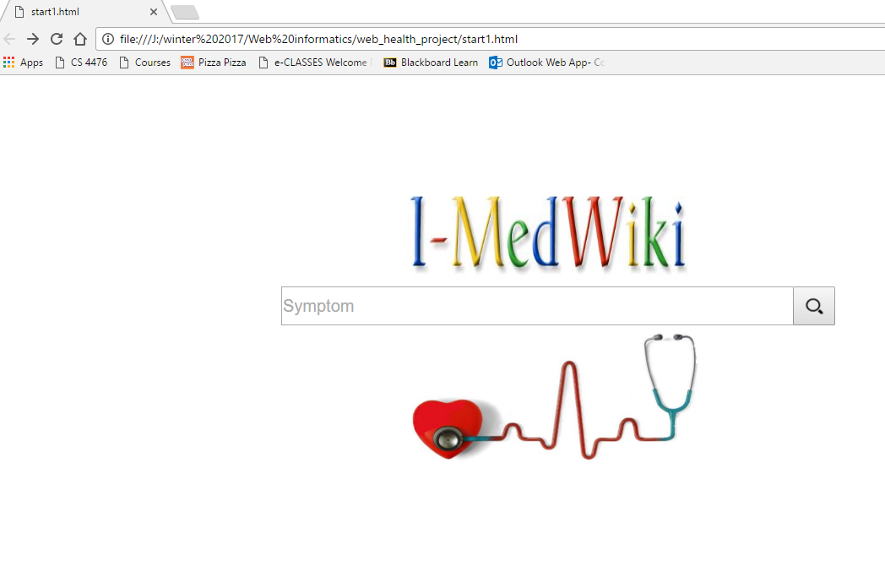
Sneak - Peek

Slide 12


